Slide 1
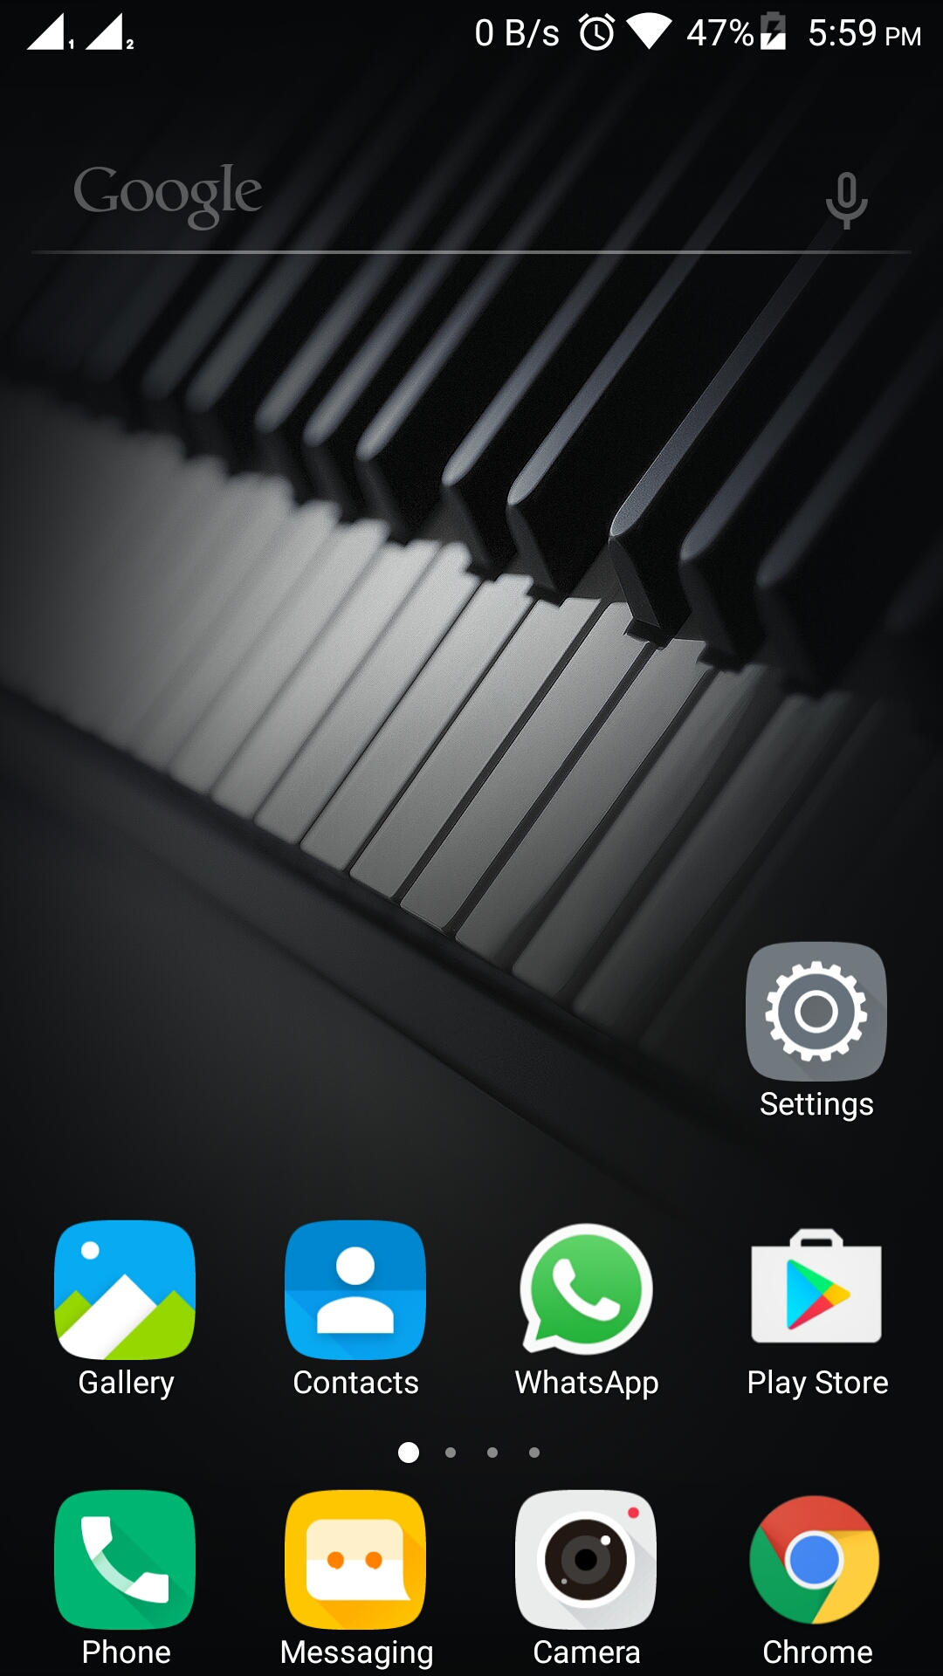

Step 1: Use in Presentation Mode to access clickable features of wireframe.
Step 2: Click on ChefAtHome icon in mobile screen to star.
CAH Mobile APP Wireframe
-MRINAL MISHRA
ChefAtHome
Phone Home Screen

Slide 2


(Click anywhere to continue)
Loading…
Start Screen

Slide 3


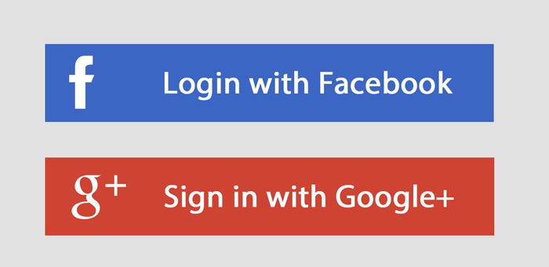

Sign Up
First Name *
Last Name
Mobile number
Email / Mobile number *
Email ID
Password *
Password *
(Click on
Login Button
to continue)
LOGIN
Confirm Password *
Forgot your password?
Submit
New User?
Sign Up
Fields with ‘*’ mark are mandatory
User Sign-up and Login

Slide 4












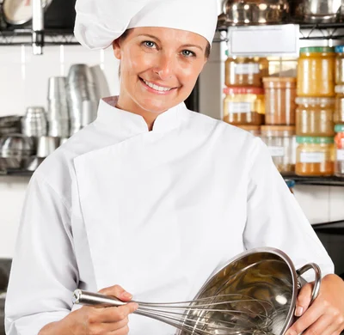
39800 Fremont Blvd
(Click on home icon to see all details on homepage)
$$$
$$
Don Francis 4.5⭐️ Member Since 2020 1.3 mi
Mexican, Vegan, Italian Cuisines
Ashley Jones 4.8⭐️ Member Since 2021 2.8 mi
Russian, Ukrainian, Polish Cuisines
$
$$$$
Tess Brown 4.7⭐️ Member Since 2022 4.2 mi
Italian, French, Spanish Cuisines
Lisa Rose 4.6⭐️ Member Since 2023 5.7 mi
Mediterranean, Italian, Turkish Cuisines
Home Page

Slide 5
Push Notifications
(These icons can be clicked)
Select the location you want the service at/near
Cart to see the selected orders
39800 Fremont Blvd
[Note: Always click on home icon to come back to his page]
User Account Section (Click this icon to explore this section)
Search chefs based on cuisine type, dish, or chef’s name
$$$
$$
Filter Options:
Cuisine Type
Ratings
Price Range
Distance
Sort Options:
Ratings
Price Range
Distance
Show chefs which were marked as favorites (Click this icon to check favorites)
Chef Profiles:
Featured Image
Name
Ratings
Member Since
Distance
Cuisine Types
Price Range (Click on this Chef to see detailed profile page and proceed with the booking)
Don Francis 4.5⭐️ Member Since 2020 1.3 mi
Mexican, Vegan, Italian Cuisines
Ashley Jones 4.8⭐️ Member Since 2021 2.8 mi
Russian, Ukrainian, Polish Cuisines
Option to mark as “Favorite”
$
$$$$
Tess Brown 4.7⭐️ Member Since 2022 4.2 mi
Italian, French, Spanish Cuisines
Lisa Rose 4.6⭐️ Member Since 2023 5.7 mi
Mediterranean, Italian, Turkish Cuisines
Home Page (Detailed)

Slide 6
39800 Fremont Blvd
Don Francis 4.5⭐️ Member Since 2020 1.3 mi
Mexican, Vegan, Italian Cuisines
(Click to see customer reviews page)
See customer reviews here
Meet Chef Don Francis – Your Personal Gourmet Specialist!**
With over a decade of culinary mastery, Chef Don brings a world of flavors to your home.
As a dedicated member since 2020, he has charmed clients with his vibrant Mexican dishes, authentic Italian pastas, and creative vegan delights.
Chef Don believes in crafting meals that not only satisfy but also tell a story.
He’s always ready to deliver a personalized, restaurant-style experience in your kitchen.
Get ready to indulge in a unique dining journey as Chef Don combines fresh ingredients, rich flavors, and his exceptional skill to make every meal unforgettable.
Book Now
(Click here to proceed to booking form)
Chef Profile Page

Slide 7
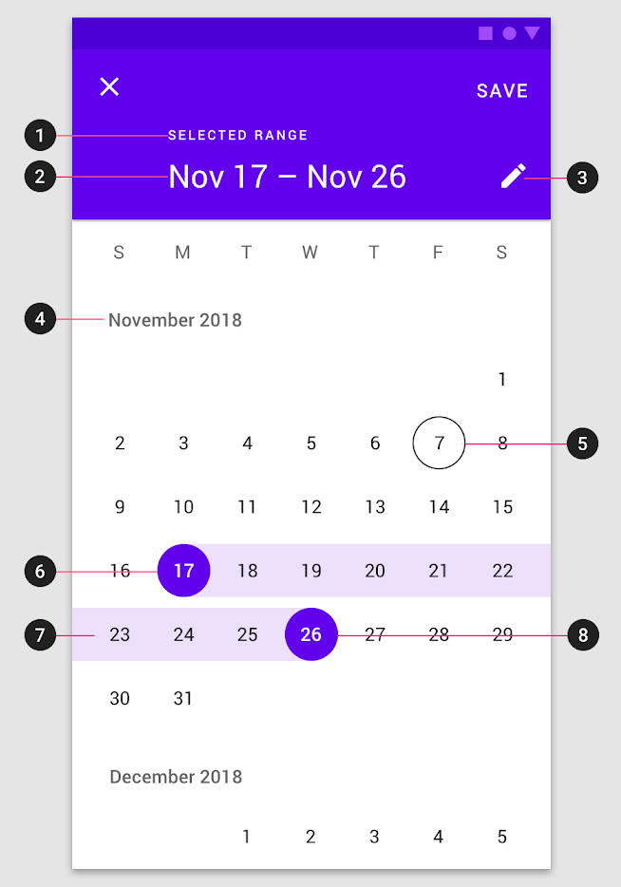


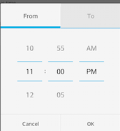
39800 Fremont Blvd
Booking Form
Single Day
Multiple Day
One Time
Periodic
Select Occasion
Number of guests
Street address of the event
City
State
Zip
Cuisine Type and Dishes
Food Restrictions (Vegan/Gluten Free/ etc.)
Food Allergies (If any)
(Click here to add this booking to cart)
Add to cart
Book Now
(Click here to proceed to payment)
Booking Form Page

Slide 8
39800 Fremont Blvd
1
(Click on home icon or my account icon)
Confirm Order Details Page (Assuming order details are shown here)
Confirm Order Details Page

Slide 9
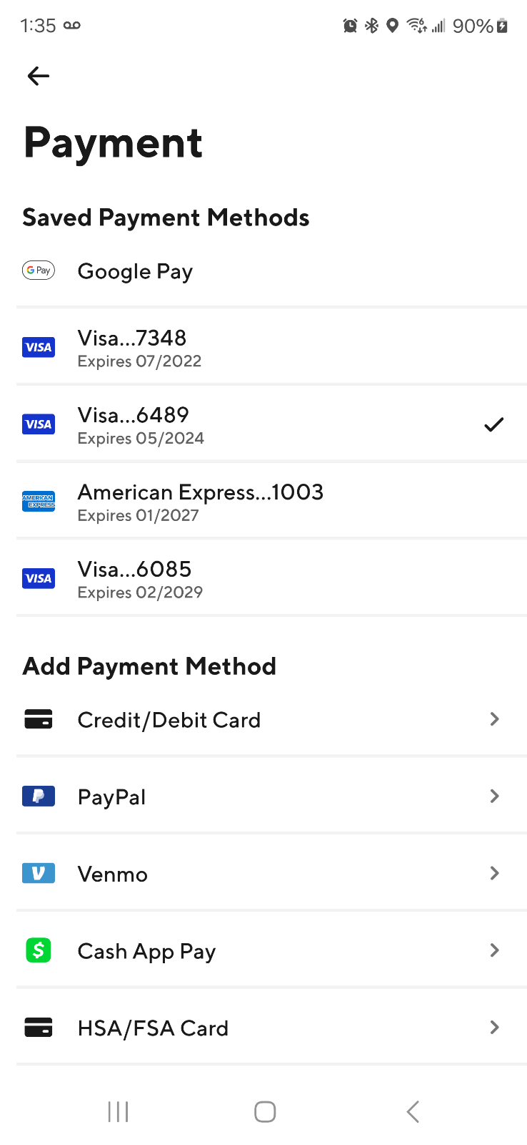
39800 Fremont Blvd
Discount Code (optional)
Add Tip (optional)
Pay Now
(Click here to complete the payment and redirect to order history page)
Payments Page

Slide 10
39800 Fremont Blvd
(Click on home icon or my account icon)
Order History Page (Assuming past orders are shown here)
Order History Page

Slide 11
39800 Fremont Blvd
1
(Click on home icon or my account icon)
Cart Items Page (Assuming cart items are shown here)
Cart Items Page

Slide 12
39800 Fremont Blvd
(Click on home icon or my account icon)
Notifications Page (Assuming push notifications are shown here)
Notifications Page

Slide 13
39800 Fremont Blvd
(Click on home icon or my account icon)
Saved Addresses Page (Assuming saved addresses are shown here)
Saved Addresses Page

Slide 14
39800 Fremont Blvd
(Click on home icon or my account icon)
Contact Us Page (Assuming contact us info shown here)
Contact Us Page

Slide 15
39800 Fremont Blvd
(Click on home icon or my account icon)
Customer Review Page (Assuming reviews for selected chef shown here)
Customer Review Page

Slide 16
39800 Fremont Blvd
(Click on home icon or my account icon)
Discount Code (optional)
Add Tip (optional)
Pay Now
Payments Page

Slide 17
39800 Fremont Blvd
$$$
$$
Don Francis 4.5⭐️ Member Since 2020 1.3 mi
Mexican, Vegan, Italian Cuisines
Ashley Jones 4.8⭐️ Member Since 2021 2.8 mi
Russian, Ukrainian, Polish Cuisines
$
$$$$
Tess Brown 4.7⭐️ Member Since 2022 4.2 mi
Italian, French, Spanish Cuisines
Lisa Rose 4.6⭐️ Member Since 2023 5.7 mi
Mediterranean, Italian, Turkish Cuisines
Home Page

Slide 18
39800 Fremont Blvd
$$$
$$$$
Don Francis 4.5⭐️ Member Since 2020 1.3 mi
Mexican, Vegan, Italian Cuisines
Lisa Rose 4.6⭐️ Member Since 2023 5.7 mi
Mediterranean, Italian, Turkish Cuisines
Favorites Page

Slide 19
39800 Fremont Blvd
MM
Mrinal Mishra
View Profile
Order History
Saved Addresses
Payment Methods
Manage Favorites
Contact Us
Log Out
My Account

